Slide 1
Chapter 9
Search Algorithms

Slide 2
Chapter Objectives
Learn the various search algorithms
Explore how to implement the sequential and binary search algorithms
Discover how the sequential and binary search algorithms perform
Become aware of the lower bound on comparison-based search algorithms
Learn about hashing

Slide 3
class arrayListType: Basic Operations
isEmpty
isFull
listSize
maxListSixe
Print
isItemAtEqual
insertAt
insertEnd
removeAt
retrieveAt
replaceAt
clearList
seqSearch
insert
remove
arrayListType

Slide 4
Sequential Search
template<class elemType>
int arrayListType<elemType>::seqSearch(const elemType& item)
{
int loc;
bool found = false;
for(loc = 0; loc < length; loc++)
if(list[loc] == item)
{
found = true;
break;
}
if(found)
return loc;
else
return -1;
}//end seqSearch

Slide 5
Search Algorithms
Search item: target
To determine the average number of comparisons in the successful case of the sequential search algorithm:
  Consider all possible cases
  Find the number of comparisons for each case
  Add the number of comparisons and divide by the number of cases

Slide 6



Search Algorithms
Suppose that there are n elements in the list. The following expression gives the average number of comparisons:
It is known that
Therefore, the following expression gives the average number of comparisons made by the sequential search in the successful case:

Slide 7
Ordered Lists as Arrays
template<class elemType>
class orderedArrayListType: public arrayListType<elemType>
{
public:
orderedArrayListType(int size = 100);
//constructor
...
//We will add the necessary members as needed.
private:
//We will add the necessary members as needed.
}

Slide 8
Ordered Lists as Linked Lists
template<class elemType>
class orderedLinkedListType: public linkedListType<elemType>
{
public:
...
}

Slide 9
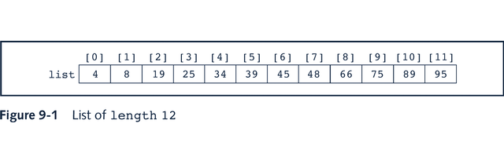

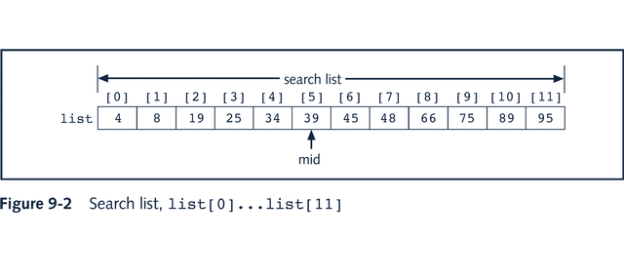
Binary Search

Slide 10
Binary Search: middle element
first + last
mid =
2

Slide 11
Binary Search
template<class elemType>
int orderedArrayListType<elemType>::binarySearch
(const elemType& item)
{
int first = 0;
int last = length - 1;
int mid;
bool found = false;
while(first <= last && !found)
{
mid = (first + last) / 2;
if(list[mid] == item)
found = true;
else
if(list[mid] > item)
last = mid - 1;
else
first = mid + 1;
}
if(found)
return mid;
else
return –1;
}//end binarySearch

Slide 12
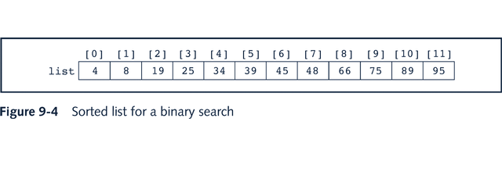

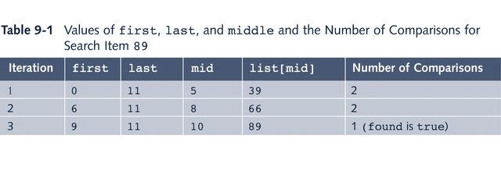
Binary Search: Example

Slide 13
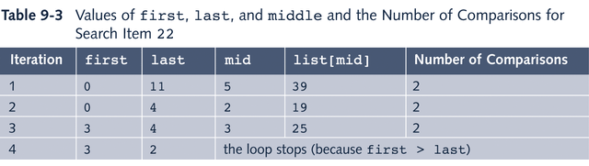
Binary Search: Example
Unsuccessful search
Total number of comparisons is 6

Slide 14
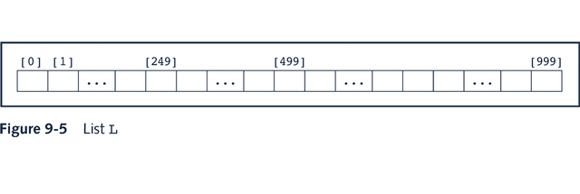

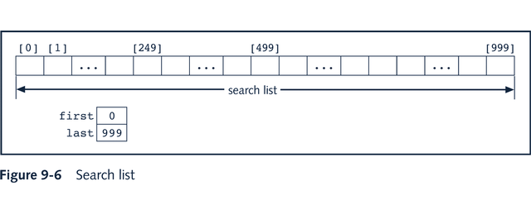
Performance of Binary Search

Slide 15
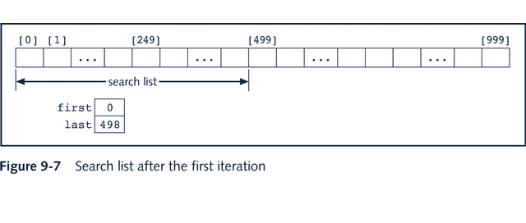
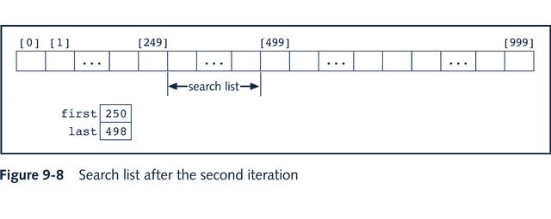
Performance of Binary Search

Slide 16
Performance of Binary Search
Unsuccessful search
  for a list of length n, a binary search makes approximately 2*log2(n + 1) key comparisons
Successful search
  for a list of length n, on average, a binary search makes 2*log2n – 4 key comparisons

Slide 17
Binary Search and Insertion
template<class elemType>
class orderedArrayListType: public arrayListType<elemType>
{
public:
void insertOrd(const elemType&);
int binarySearch(const elemType& item);
orderedArrayListType(int size = 100);
};

Slide 18
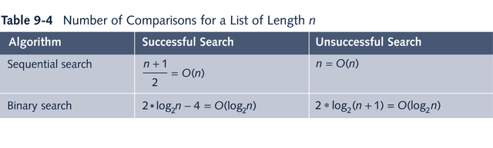
Search Algorithm Analysis Summary

Slide 19
Lower Bound on Comparison-Based Search
Theorum: Let L be a list of size n > 1. Suppose that the elements of L are sorted. If SRH(n) denotes the minimum number of comparisons needed, in the worst case, by using a comparison-based algorithm to recognize whether an element x is in L, then SRH(n) = log2(n + 1).
Corollary: The binary search algorithm is the optimal worst-case algorithm for solving search problems by the comparison method.

Slide 20
Hashing
Main objectives to choosing hash functions:
  Choose a hash function that is easy to compute
  Minimize the number of collisions

Slide 21
Commonly Used Hash Functions
Mid-Square
  Hash function, h, computed by squaring the identifier
  Using appropriate number of bits from the middle of the square to obtain the bucket address
  Middle bits of a square usually depend on all the characters, it is expected that different keys will yield different hash addresses with high probability, even if some of the characters are the same

Slide 22
Commonly Used Hash Functions
Folding
  Key X is partitioned into parts such that all the parts, except possibly the last parts, are of equal length
  Parts then added, in convenient way, to obtain hash address
Division (Modular arithmetic)
  Key X is converted into an integer iX
  This integer divided by size of hash table to get remainder, giving address of X in HT

Slide 23
Commonly Used Hash Functions
Suppose that each key is a string. The following C++ function uses the division method to compute the address of the key:
int hashFunction(char *key, int keyLength)
{
int sum = 0;
for(int j = 0; j <= keyLength; j++)
sum = sum + static_cast<int>(key[j]);
return (sum % HTSize);
}//end hashFunction

Slide 24
Collision Resolution
Algorithms to handle collisions
Two categories of collision resolution techniques
  Open addressing (closed hashing)
  Chaining (open hashing)

Slide 25
Collision Resolution:
Open Addressing
Pseudocode implementing linear probing:
hIndex = hashFunction(insertKey);
found = false;
while(HT[hIndex] != emptyKey && !found)
if(HT[hIndex].key == key)
found = true;
else
hIndex = (hIndex + 1) % HTSize;
if(found)
cerr<<”Duplicate items are not allowed.”<<endl;
else
HT[hIndex] = newItem;

Slide 26
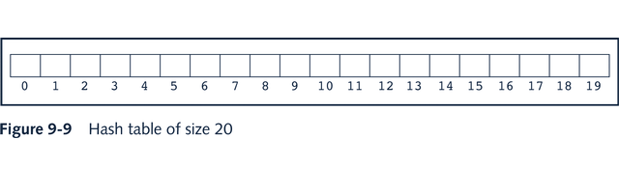
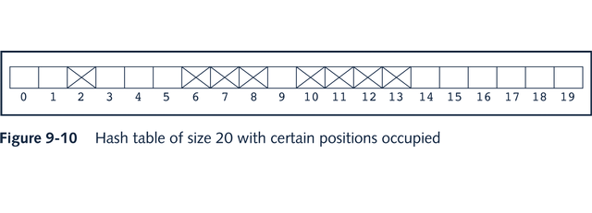
Linear Probing

Slide 27
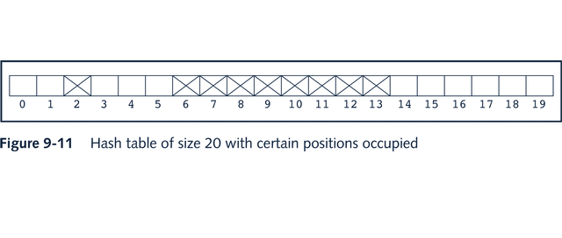
Linear Probing

Slide 28
Random Probing
Uses a random number generator to find the next available slot
ith slot in the probe sequence is: (h(X) + ri) % HTSize where ri is the ith value in a random permutation of the numbers 1 to HTSize – 1
All insertions and searches use the same sequence of random numbers

Slide 29
Quadratic Probing
Reduces primary clustering
We do not know if it probes all the positions in the table
When HTSize is prime, quadratic probing probes about half the table before repeating the probe sequence

Slide 30
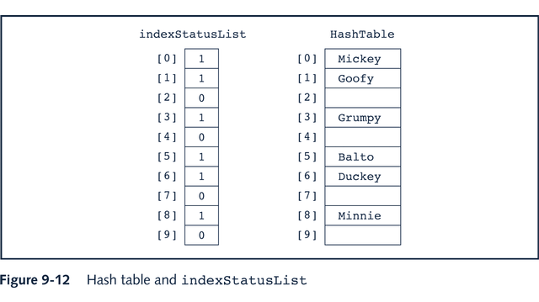
Deletion: Open Addressing

Slide 31
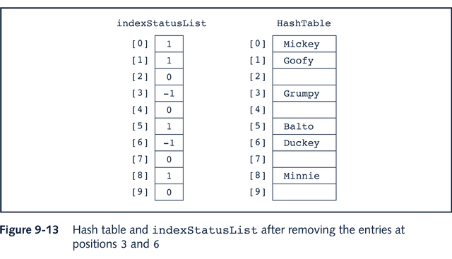
Deletion: Open Addressing

Slide 32
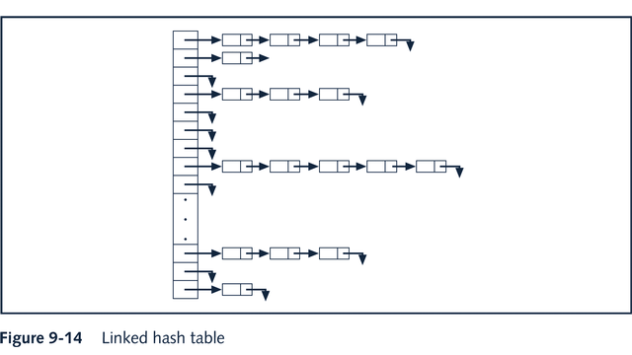
Collision Resolution:
Chaining (Open Hashing)

Slide 33

Hashing Analysis
Let
Then a is called the load factor

Slide 34


Linear Probing:
Average Number of Comparisons
1. Successful search
2. Unsuccessful search

Slide 35


Quadratic Probing:
Average Number of Comparisons
1. Successful search
2. Unsuccessful search

Slide 36


Chaining:
Average Number of Comparisons
1. Successful search
2. Unsuccessful search

Slide 37
Chapter Summary
Search Algorithms
  Sequential
  Binary
Algorithm Analysis
Hashing
  Hash Table
  Hash function
  Collision Resolution

